Slide 1


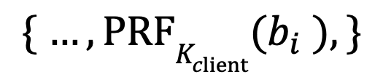


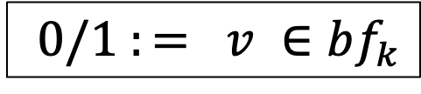
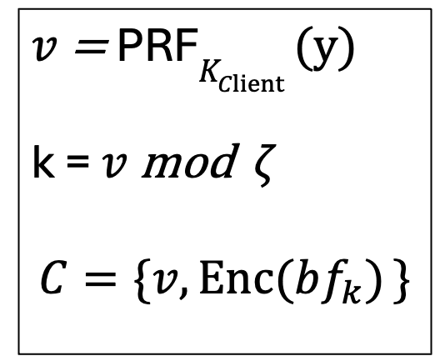
F_{AuthOPRF}
Preprocess
(one-time)
$$\{ …, PRFK_{client}(b_{i} ), \}$$
$$K_{client}$$
$$Bblind =$$
{ …,${ H}_{1}$(b)^{r} ,… }
$$T_{B} = \{…, Enc(bf_{k} ),…\}$$
Search
$$C$$
$v$= PRF$K_{Client} (y)$
k = $v$ mod $ζ$
$$C=\{v,Enc(bf_{k}) \}$$
$$0/1 := v ∈bf_{k}$$

